Slide 1
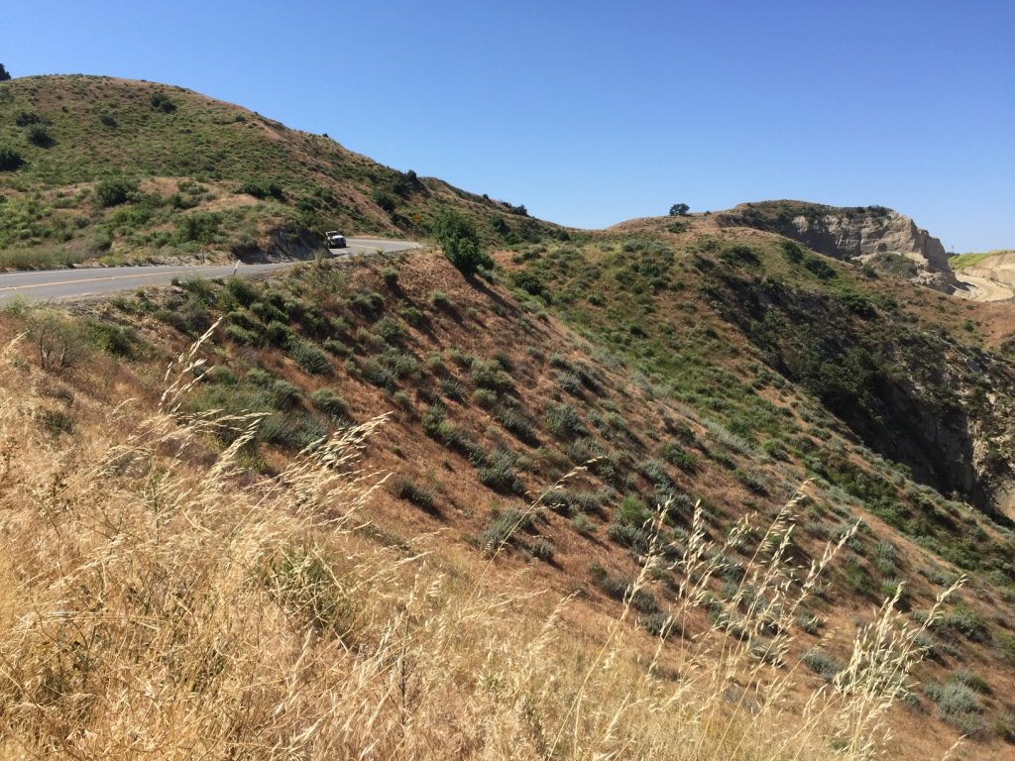

Slide 6
When the mountains have all been taken will we still gaze upward?

